Slide 1

MONTHLY SALES FORCASTING GROUP ASSIGNMENT
MSc Data Science, Coventry University UK
(2024 Batch)
Group-1

Slide 2






THE TEAM
Tharinda
COMScDS241P-001
Dinesh
COMScDS241P-002
Dinushi
COMScDS241P-003
Arosha
COMScDS241P-004
Osanda
COMScDS241P-019

Slide 3

OUR AIM
We are tasked with analyzing the past sales and some other data collected by the ABC Marketing Company Pvt (Ltd) and build a forecasting model to help the company to improve their sales performance.

Slide 4

COMPANY OUTLOOK
Stores | Departments
45 Stores Island Wide | 99 Different Departments

Slide 5
DATASETS: FEATURE
Additional data related to the store, department, and regional activity for the given dates
Store: Store Number
Date: Dates of the data from 2010 February 05th - 2013 July 26th
Temperature: Temperature in Fahrenheit
Fuel Price: Price of Fuel on that day
Markdown1, Markdown2, Markdown3, Markdown4, Markdown5: Data related to promotional markdowns at ABC which are anonymous
CPI: The consumer price index which measures the monthly changes in prices paid by consumers
Unemployment: Rate of Unemployment
IsHoliday: Whether a particular day is a holiday or not
8190
12
Total Records
Total Columns
Summary Statistics
Statistic | Store | Temperature | Fuel Price | Markdown1 | Markdown2 | Markdown3 | Markdown4 | Markdown5 | CPI | Unemployment
Count | 8190 | 8190 | 8190 | 4032 | 2921 | 3613 | 3464 | 4050 | 7605 | 7605
Mean | 23 | 59.356 | 3.406 | 7032.372 | 3384.177 | 1760.1 | 3292.936 | 4132.216 | 172.461 | 7.827
Std Dev | 12.988 | 18.679 | 0.431 | 9262.747 | 8793.583 | 11276.46 | 6792.33 | 13086.69 | 39.738 | 1.877
Min | 1 | -7.29 | 2.472 | -2781.45 | -265.76 | -179.26 | 0.22 | -185.17 | 126.064 | 3.684
25% | 12 | 45.903 | 3.041 | 1577.533 | 68.88 | 6.6 | 304.688 | 1440.828 | 132.365 | 6.634
50% (Median) | 23 | 60.71 | 3.513 | 4743.58 | 364.57 | 36.26 | 1176.425 | 2727.135 | 182.764 | 7.806
75% | 34 | 73.88 | 3.743 | 8923.31 | 2153.35 | 163.15 | 3310.008 | 4832.555 | 213.932 | 8.567
Max | 45 | 101.95 | 4.468 | 103185 | 104519.5 | 149483.3 | 67474.85 | 771448.1 | 228.976 | 14.313

Slide 6
DATASETS: TRAIN
Historical training data
Store: Store Number
Dept: Department Number
Date: Dates of the data from 2010–02–05 to 2012-10-26
Weekly_Sales: Weekly sales of the store in a particular department
IsHoliday: Whether a particular day is a holiday
421570
5
Total Records
Total Columns
Summary Statistics
Statistic | Store | Dept | Weekly Sales
Count | 421570 | 421570 | 421570
Mean | 22.201 | 44.26 | 15981.26
Std Dev | 12.785 | 30.492 | 22711.18
Min | 1 | 1 | -4988.94
25% | 11 | 18 | 2079.65
50% (Median) | 22 | 37 | 7612.03
75% | 33 | 74 | 20205.85
Max | 45 | 99 | 693099.4

Slide 7
DATASETS: STORE
Information about the 45 stores, indicating the type and size of the store
Store: Store Number
Type: The type of the Store which can be A,B,C
Size: Size of the Store
45
3
Total Records
Total Columns
Summary Statistics
Statistic | Store | Size
Count | 45 | 45
Mean | 23 | 130287.6
Std Dev | 13.13393 | 63825.27
Min | 1 | 34875
25% | 12 | 70713
50% (Median) | 23 | 126512
75% | 34 | 202307
Max | 45 | 219622

Slide 8
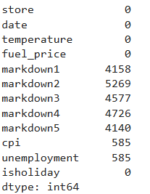
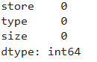
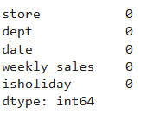
DATA PRE-PROCESSING
Features Data Set
Store Data Set
Train Data Set

Slide 9
DATA VISUALIZATION
Various plots (histograms, scatter plots, bar charts)
Heatmaps for correlation analysis
Trend analysis using line charts

Slide 10
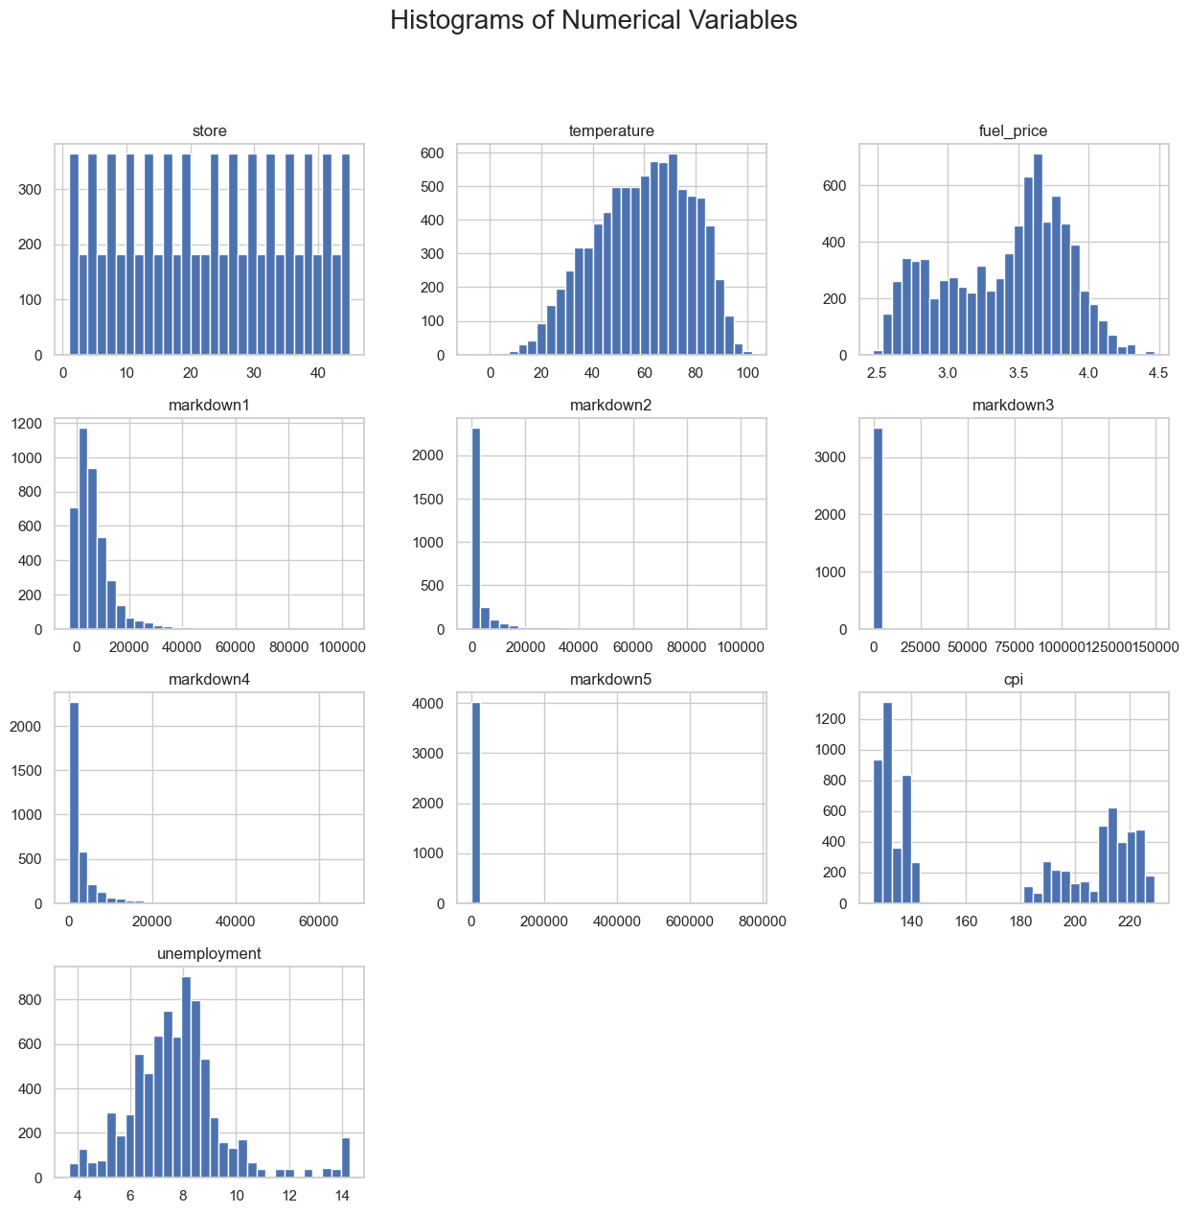
HISTOGRAM OF NUMERICAL VARIABLES
Temperature: The histogram shows a normal distribution with most values concentrated around 60–70°F.
Fuel Price: A bimodal distribution is observed, indicating two common price ranges.
Markdowns: Skewed distributions are evident, with most values clustered at lower levels.
CPI and Unemployment: These variables display variability, with unemployment mostly around 7–8%.
Store Types: Variations in store sizes are evident, with distinct patterns across categories such as Type A, B, and C.

Slide 11
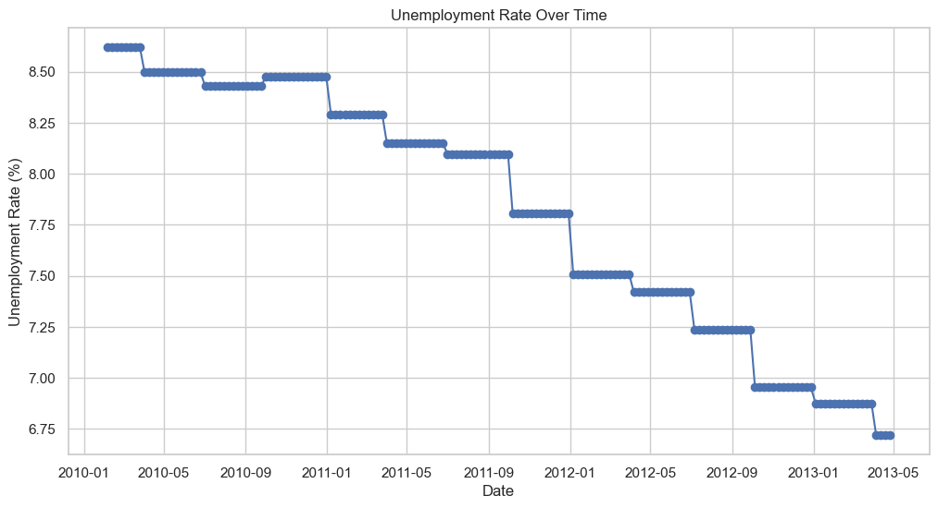
TRENDS IN UNEMPLOYMENT RATES
Overall Decline: The unemployment rate shows a clear decline from January 2010 to May 2013, dropping from approximately 8.5% to 6.75%.
Stepwise Decrease: The trend occurs in steps rather than a smooth decline, indicating periods of stability followed by significant drops.
Notable Events: Sudden drops around mid-2011 and early 2012 may reflect economic recovery measures or impactful policies.

Slide 12
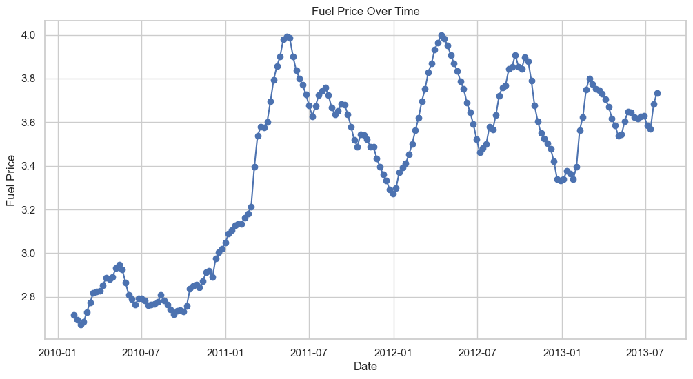
TRENDS IN FUEL PRICES (2010–2013)
Notable Peaks: Fuel prices experienced significant peaks around mid-2011 and mid-2012, with the highest point nearing $4.00.
Overall Volatility: Prices fluctuated throughout the period, indicating unstable market conditions.
Gradual Declines: After mid-2012, prices show a steady decline, suggesting a possible market correction or stabilization.

Slide 13
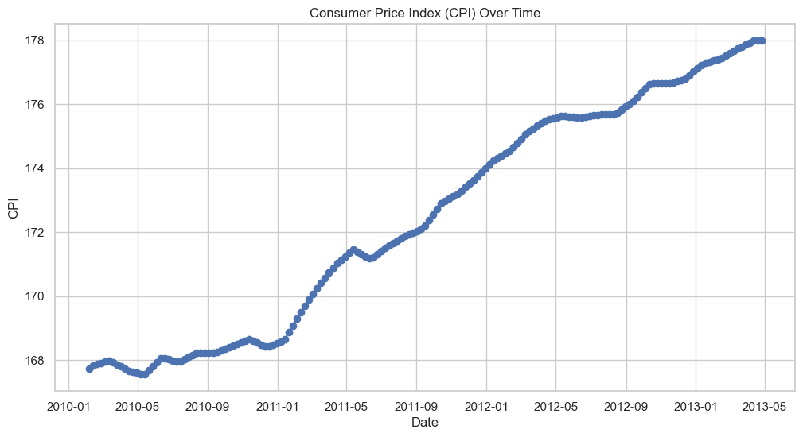
TRENDS IN CONSUMER PRICE INDEX (CPI) OVER TIME
Steady Growth: The CPI shows a general upward trend from January 2010 to May 2013, indicating a gradual increase in the cost of goods and services.
Seasonal Fluctuations: There are noticeable short-term fluctuations in CPI, possibly linked to seasonal changes or economic conditions.
Economic Indicator: The trend reflects changes in economic conditions during the period, providing valuable insight for analysis.
Visual Emphasis: The x-axis spans from 2010-01 to 2013-05, while the y-axis ranges from 168 to 178, highlighting the consistent growth within this range.

Slide 14
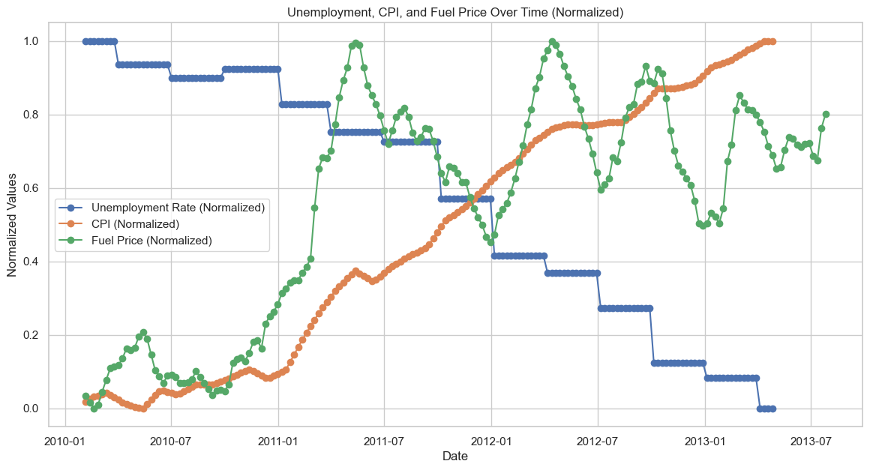
TRENDS IN ECONOMIC INDICATORS (2010–2013)
Unemployment: The blue-stepped line shows a general decline from 2010 to 2013, indicating improving employment conditions.
CPI (Consumer Price Index): The orange line with markers highlights a steady increase, reflecting a gradual rise in the cost of goods and services.
Fuel Price: The green line with triangular markers displays fluctuations, with notable peaks and troughs, highlighting market volatility.

Slide 15
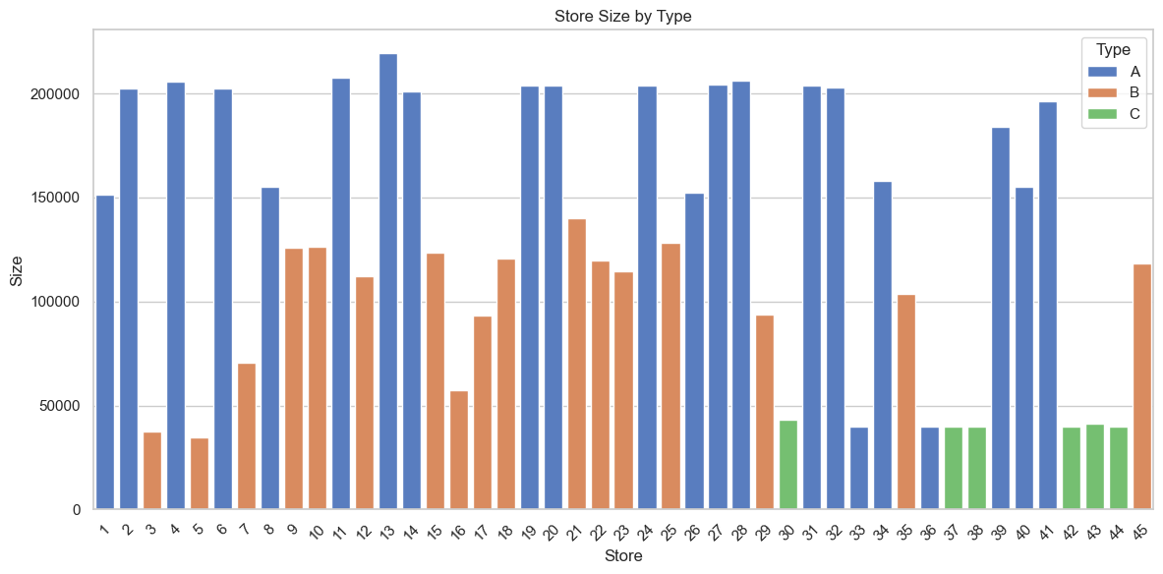
STORE SIZE VARIATIONS ACROSS CATEGORIES
Store Type Distribution: Type A stores have the largest sizes overall, followed by Type B and Type C, indicating a hierarchy in size distribution across categories.
Wide Size Range: Type A stores show a significant size range, suggesting diverse operational scales, while Type C stores tend to be consistently smaller.
Business Implications: The variations in store sizes may reflect different business models, target audiences, or inventory capacities within each category.

Slide 16
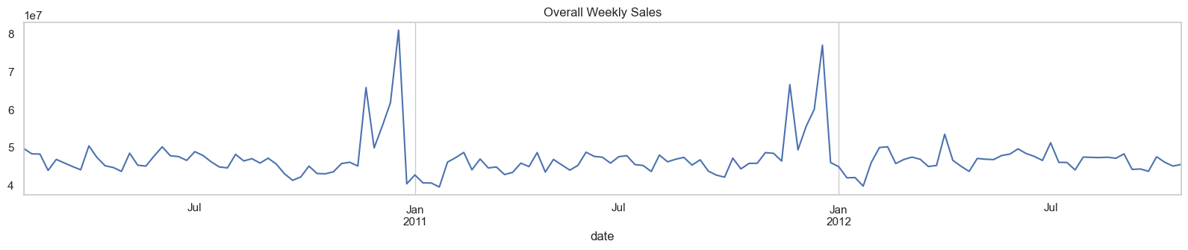
TRENDS IN WEEKLY SALES OVER TIME
Fluctuations: Weekly sales show significant variations, with notable peaks around January 2011 and January 2012, likely due to seasonal shopping patterns.
General Growth: Despite fluctuations, there is an overall upward trend in sales throughout the period from July 2010 to July 2012.
Scale of Sales: Sales values range in tens of millions, highlighting the substantial magnitude of these transactions.
Insight into Seasonality: Peaks around January suggest the impact of holiday seasons on consumer spending behaviors.

Slide 17
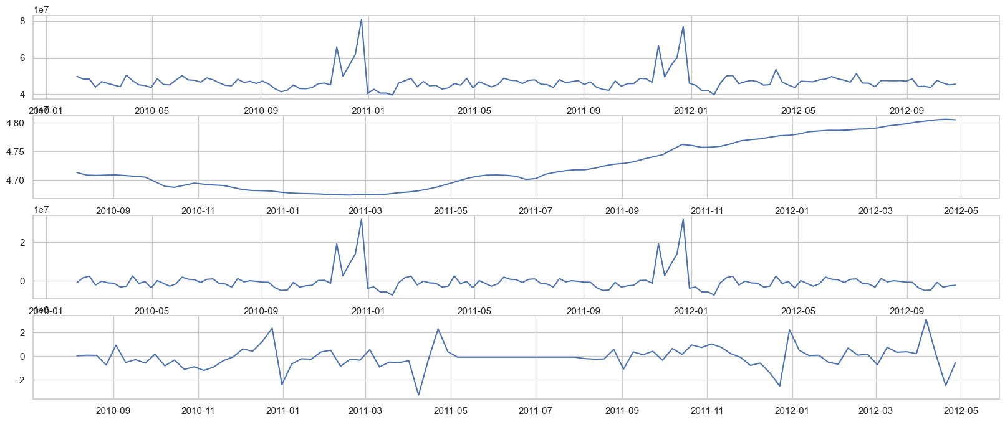
OBSERVING TRENDS ACROSS MULTIPLE METRICS
Seasonal Peaks: Certain metrics, such as the first and third graphs, show clear peaks around January 2011 and January 2012, possibly indicating seasonal trends.
Downward Trends: The second graph reveals an overall decline with minor upward adjustments, reflecting potential long-term changes.
Consistent Fluctuations: The fourth graph demonstrates regular oscillations, with peaks and troughs throughout the period.
Comparative Analysis: These graphs provide a multi-faceted view of trends over time, enabling cross-metric insights and potential correlations.

Slide 18
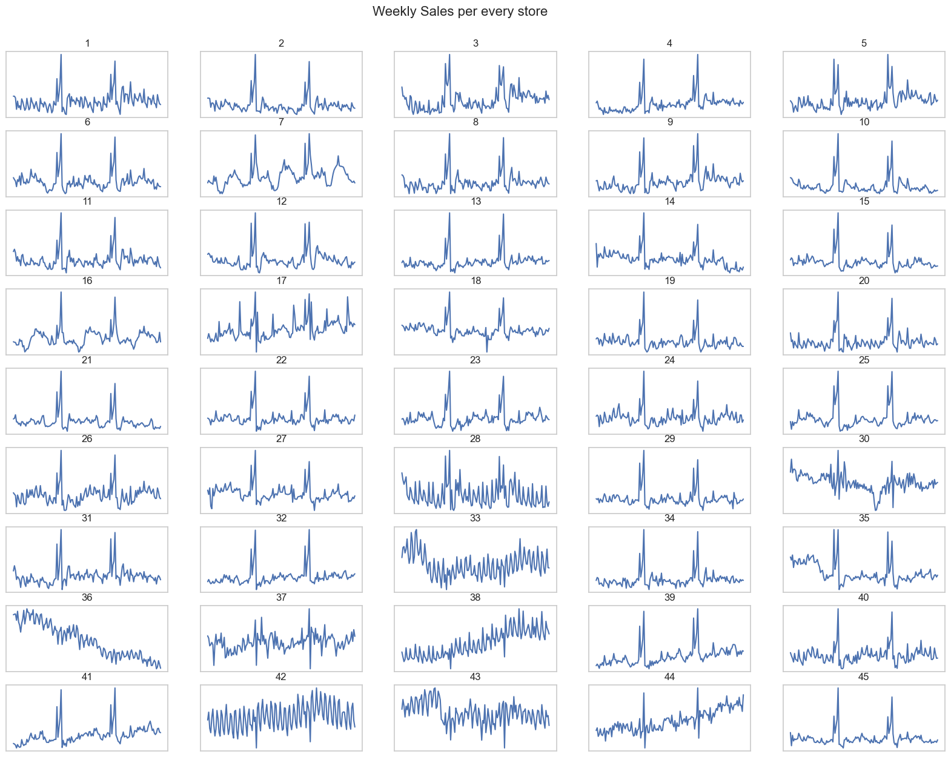
WEEKLY SALES TRENDS ACROSS STORES
Overall Trend: Each store exhibits weekly sales fluctuations, with varying degrees of peaks and dips.
Store Comparisons: Sales patterns differ across stores, with some showing consistent trends and others more inconsistent behaviors.
High and Low Performers: Identifying stores with sustained peaks or significant dips can reveal strong or underperforming stores.
Actionable Insights: This comparative analysis helps in tailoring strategies for sales growth and addressing store-specific challenges.

Slide 19
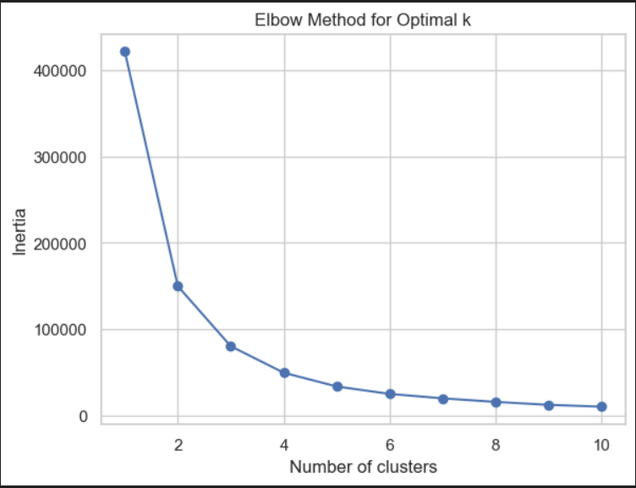
CLUSTERING METHODS
The elbow point in the graph appears to be around k = 3 or 4.
This is where the inertia (within-cluster sum of squares) stops decreasing rapidly and starts to level off.
Choosing k = 3 or 4 would likely be the best balance between minimizing inertia and avoiding overfitting.

Slide 20
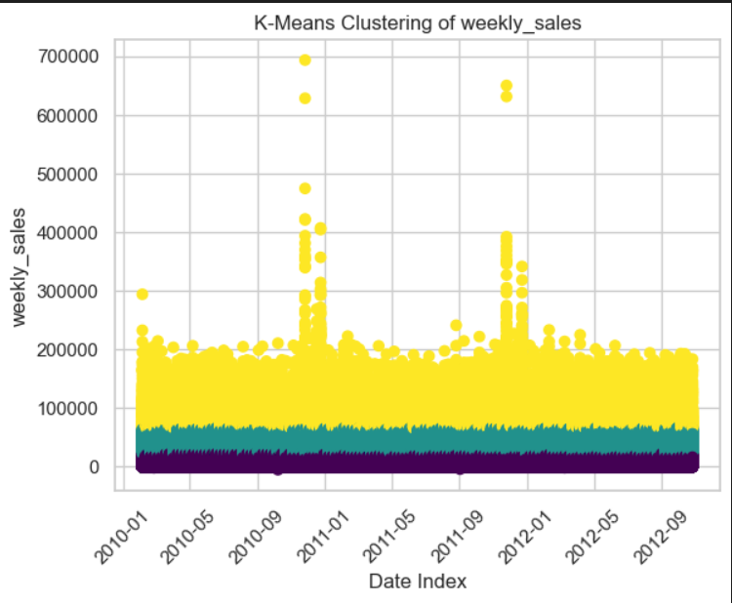
K-MEANS CLUSTERING OF WEEKLY SALES TRENDS
Clustering Sales Data – The plot represents weekly sales data clustered using the K-Means algorithm to identify patterns and trends over time.
Sales Anomalies & Peaks – The yellow cluster highlights higher sales values, showing peaks during specific periods, likely due to seasonal trends, promotions, or external factors.
Segmentation Insights – Different clusters help in understanding normal sales trends (lower clusters) versus exceptional sales spikes, aiding in strategic decision-making.

Slide 21
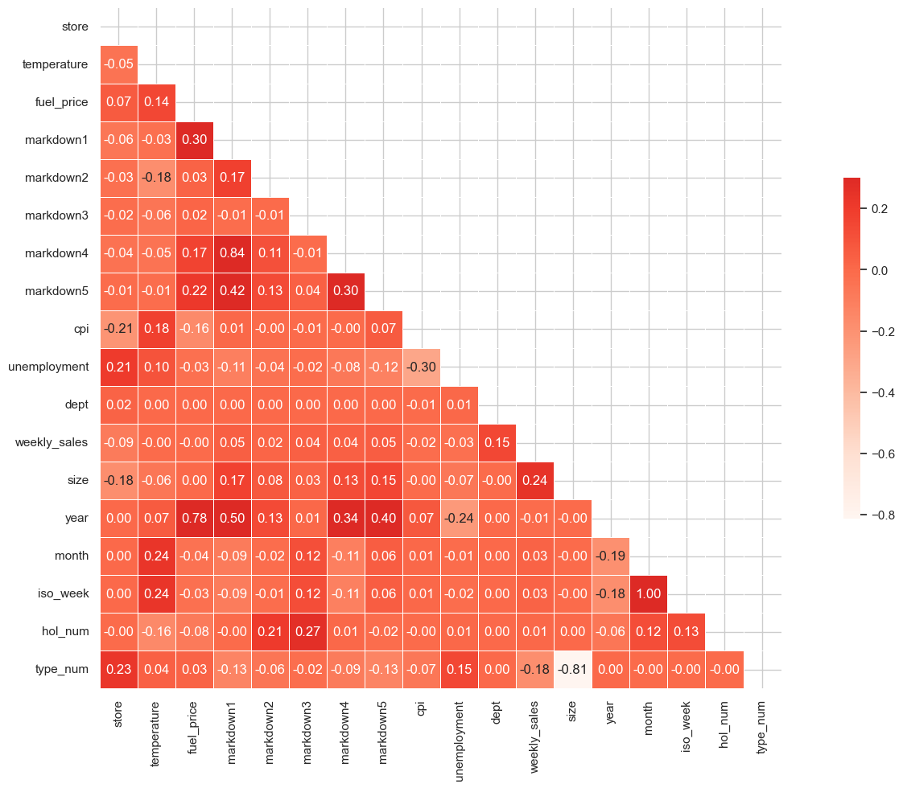
CORRELATION INSIGHTS FROM RETAIL DATA
Strong Positive Correlations: Markdown4 and Markdown5 exhibit a strong positive correlation (0.84), indicating a close relationship between these two markdown variables.
Strong Negative Correlation: The year and hol_num variables have a significant negative correlation (-0.81), suggesting an inverse relationship.
Other Relationships: Store size and weekly sales show moderate correlations, providing insights into how size impacts sales.
Analysis Potential: This heatmap offers a visual guide to understanding variable interrelations, aiding in focused data-driven decisions.

Slide 22
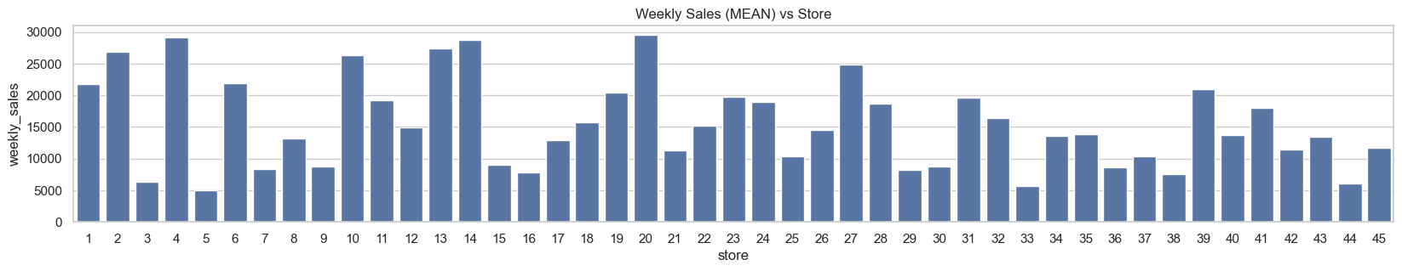
PERFORMANCE - WEEKLY SALES (MEAN) VS STORE
Store-Level Variation: The bar chart highlights significant differences in mean weekly sales across 45 stores, with some outperforming others by large margins.
High-Performing Stores: A few stores exhibit notably higher sales, indicating potential best practices or market advantages.
Sales Trends: The majority of stores cluster around mid-range sales levels, with clear outliers at both ends of the spectrum.
Business Insight: Understanding these variations can help identify factors contributing to high performance and areas for improvement.

Slide 23
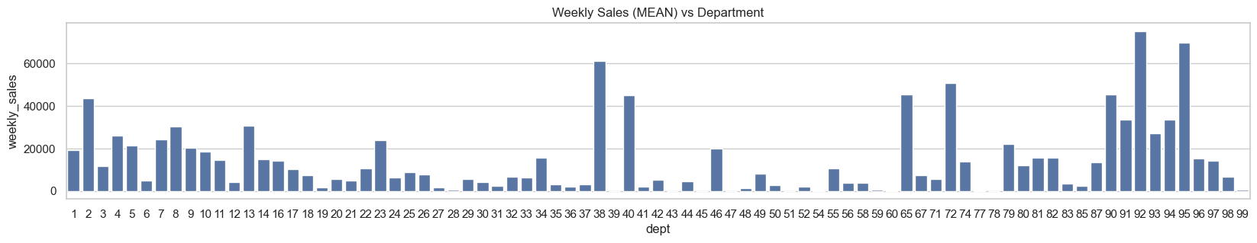
WEEKLY SALES (MEAN) VS DEPARTMENT

Slide 24
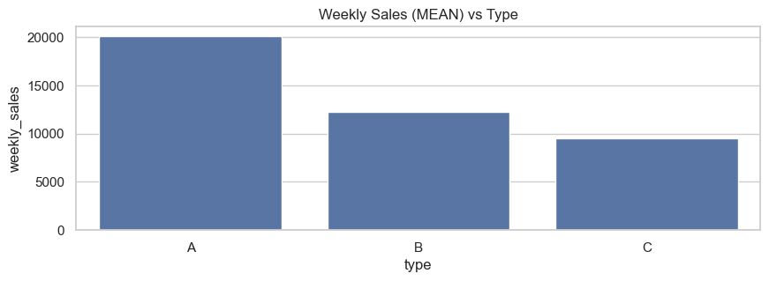
WEEKLY SALES (MEAN) VS TYPE

Slide 25
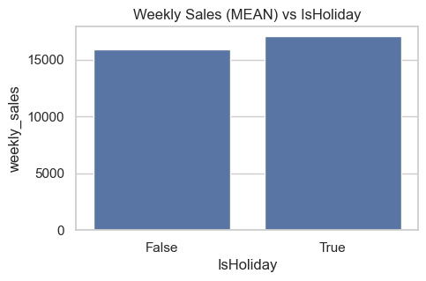
WEEKLY SALES (MEAN) VS ISHOLIDAY

Slide 26
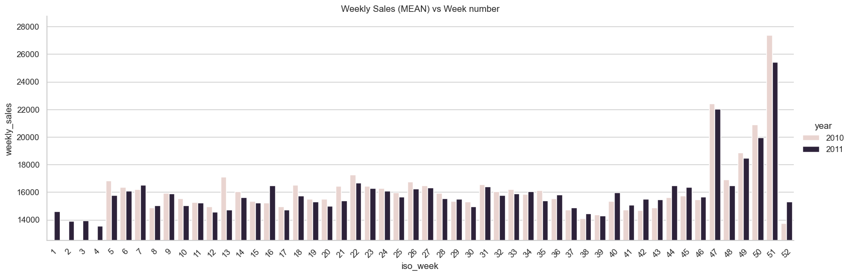
WEEKLY SALES (MEAN) VS WEEK NUMBER

Slide 27
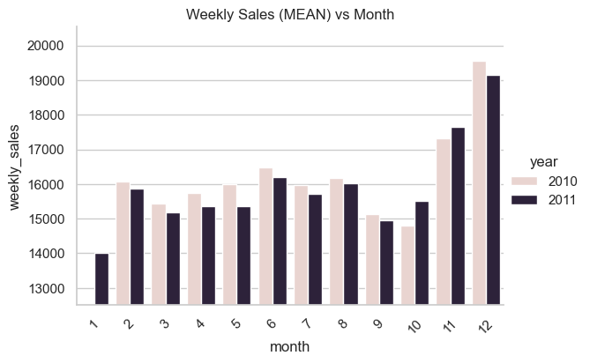
WEEKLY SALES (MEAN) VS MONTH

Slide 28
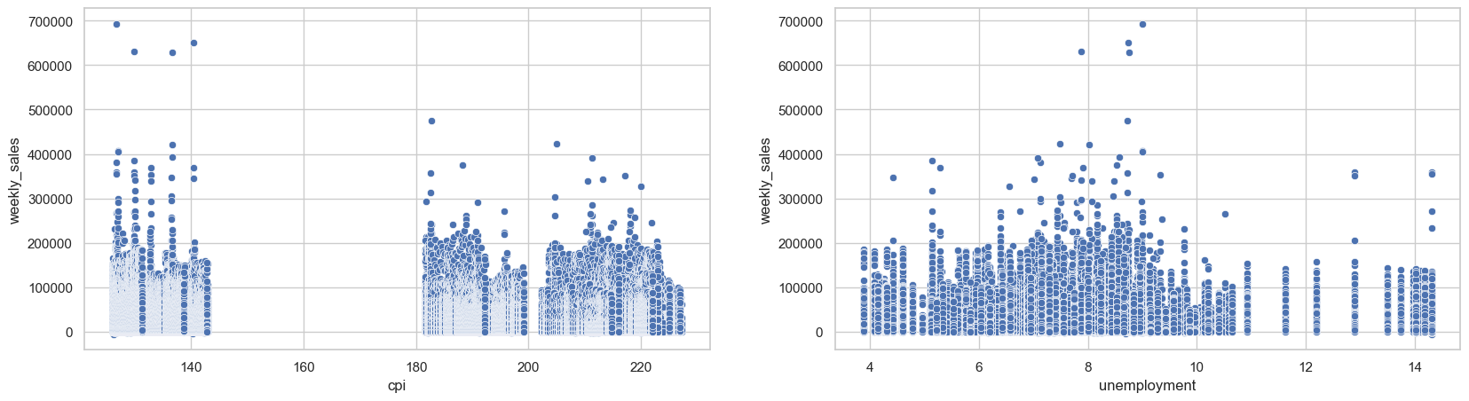
WEEKLY SALES VS CPI AND UNEMPLOYMENT RATE

Slide 29
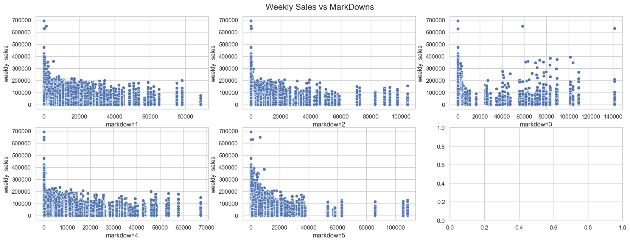
WEEKLY SALES VS MARKDOWNS

Slide 30
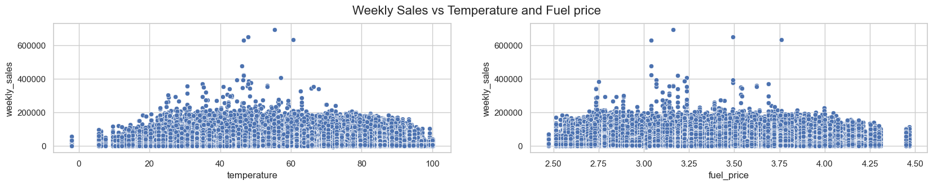
WEEKLY SALES VS TEMPERATURE AND FUEL PRICE

Slide 31
EVALUATED MODELS
Linear Regression
Random Forest Regressor
Gradient Boosting Regressor
Notes:
Explain why we select these models.

Slide 32
HYPERPARAMETERS
n_estimators - Number of trees used in the model.
Random Forest: Used 50 and 100 to train the model.
Gradient Boosting: Used 50, 100 and 200 to train the model.
Adding more estimators not significantly improve the performance but increase the computational cost and the training time.
random_state – How data is split between training and testing.
For the random forest it explains how the features are selected.
For the gradient boosting how initial weights are set.
Kept the random_state constant to ensure the consistency across runs.
max_depth – Refers to the number of levels in a decision tree.
Smaller depth limits the complexity of the model, reducing overfitting but potentially underfitting data.
Larger depth allows the model to learn more complex patterns but increase the risk of overfitting.
If the depth is not set tree will grow until a stopping criteria is met.
Model Type | n_estimators | random_state | max_depth
Random Forest Regressor | 50 | 42 | None
Random Forest Regressor | 50 | 42 | 100
Random Forest Regressor | 100 | 42 | None
Random Forest Regressor | 100 | 42 | 100
Gradient Boosting Regressor | 50 | 42 | None
Gradient Boosting Regressor | 100 | 42 | None
Gradient Boosting Regressor | 200 | 42 | None

Slide 33
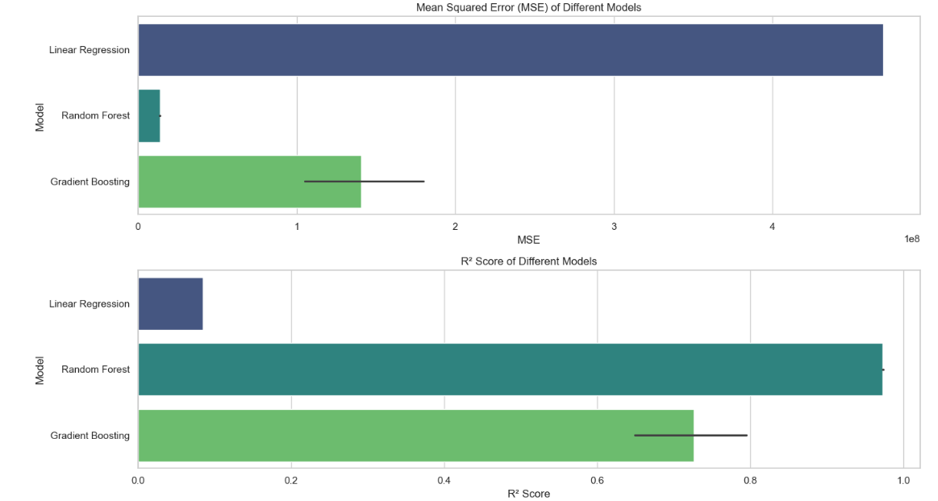
MODEL EVALUATION
Mean Squared Error (MSE) Comparison – Lower MSE values indicate better model performance. Random Forest and Gradient Boosting have significantly lower errors than Linear Regression, making them preferable choices.
R² Score Analysis – A higher R² score suggests better predictive accuracy. Random Forest achieves the highest R², followed by Gradient Boosting, while Linear Regression performs the worst.
Model Selection Insights – The results suggest that ensemble methods (Random Forest & Gradient Boosting) outperform Linear Regression, making them more suitable for this dataset.

Slide 34
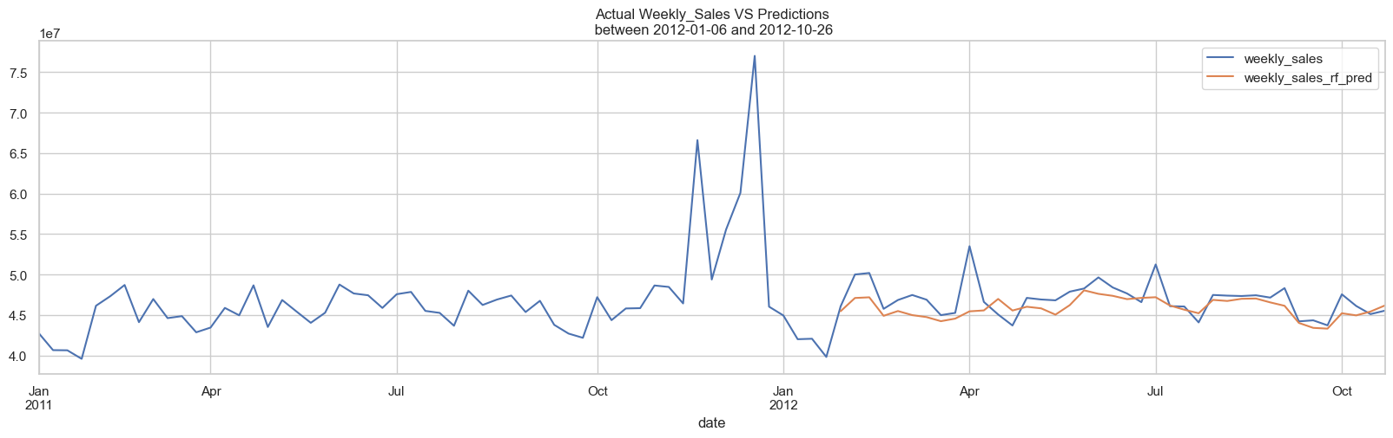
MODEL PREDICTION
Following chart shows the actual weekly vs predicted weekly sale over the all stores between the time frame of 2012 January 6th to 2012 October 26th
The orange line represents the prediction made using the trained random forest model.
Predictions closely follow the general trend of actual sales.
Predicted values align well with the actual values during periods of stability but shows some deviation during period of extreme changes.
Suggests that the model performs better at capturing steady trends than sudden variations.

Slide 35
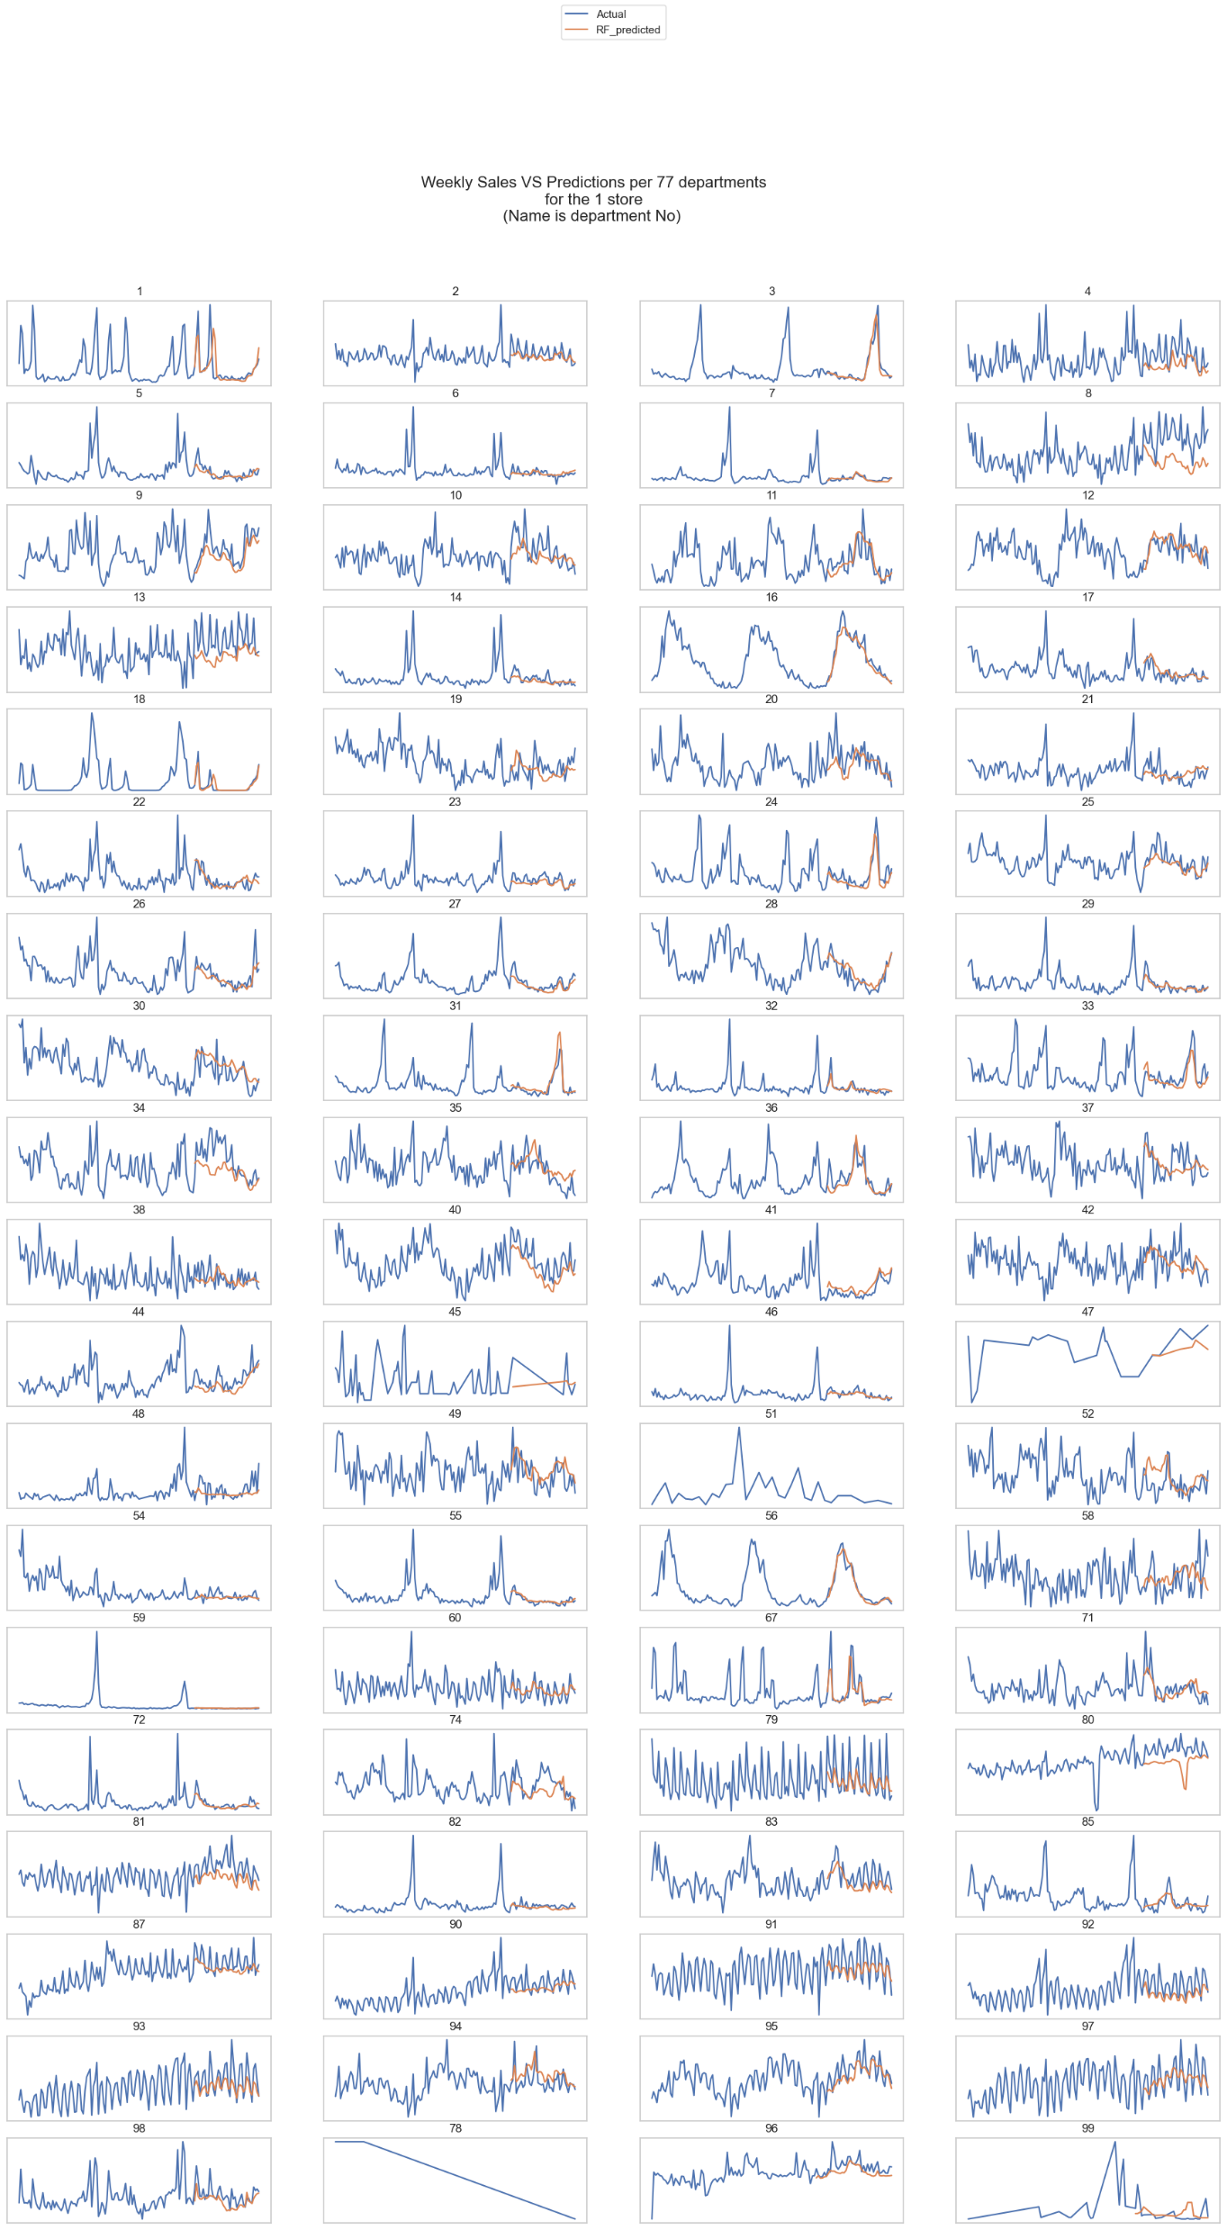
MODEL PREDICTION
Image shows the department wise prediction values of the one store and it’s 77 departments.
Across all departments, the orange line closely follows the general trend of the blue line, indicating the model captures overall patterns effectively.
There are discrepancies in some departments where sharp peaks or dips in actual sales are not fully captured by the predictions.
Can suggest that the trained random forest model performs better in departments with steady trends but struggles to predict sudden changes accurately.

Slide 36


ASSUMPTIONS
Assumed that the datasets have sufficient data.
External influences have been excluded for the prediction
Correlation of certain features may not always imply causation.
Certain noisy data has been assumed to be tolerable

Slide 37
LIMITATIONS
Limited External Data
The dataset lack certain information on external factors that may influence sales
Events
Economic factors
Weather Conditions
Consumer Behavior
Consumer preferences and purchasing patterns changes rapidly due to trends or events

Slide 38

CHALLENGES
Data Quality
Seasonality and Trends
Scalability
Missing data due to incomplete records for certain time periods
Outliers in sales of certain stores could skew the analysis and model performance
Sales data are often influenced by seasonal patterns which may affect the model accuracy
Processing and analyzing large-scale data require significant computational resources

Slide 39
GITHUB REPOSITORY
https://github.com/mdpw/msc-pds-group

Slide 40

THANK YOU!

